Slide 1
IBM University Engagement Project Submission
“Exploring the Power of Agentic AI with IBM Granite and IBM Bob”

Slide 2

Project Title – AI-Powered IPL Game Strategy Advisor
Domain of Project – Sports Analytics, Artificial Intelligence & Machine Learning
Student Name | Recent Passport Photo | Email ID | Mobile number [WhatsApp]
Dilip Seervi |  | seervidilip1234@gmail.com | 8792884966

Slide 3
Problem Statement -
Problem Statement : AI Game Strategy Advisor Agent
The Challenge
IPL teams have access to large amounts of historical match and ball-by-ball data, but extracting useful tactical insights from it is time-consuming. Manually analyzing opponent performance, batting and bowling patterns, match phases, and chasing versus defending trends makes strategic preparation difficult.
The Objective
Build an AI-powered multi-agent IPL Game Strategy Advisor that uses Agentic AI, RAG and real IPL data to generate data-driven, understandable tactical recommendations. The solution should:
Match Data Analysis – Analyze historical IPL match and ball-by-ball data to identify tactical patterns.
Opponent Strategy Analysis – Identify opponent strengths, weaknesses and historical performance trends.
Tactical Recommendation Engine – Generate data-driven batting, bowling, chasing and defending recommendations.
Strategic Insights – Provide situation-aware strategic insights.
Multi-Agent System –
Match Analysis Agent (retrieves historical data using RAG)
Opponent Strategy Agent (opponent strengths, weaknesses, trends)
Strategy Recommendation Agent (tactical recommendations)
Insight Explanation Agent (explains the recommendation and evidence)
Visualization Dashboard – Display team statistics, opponent analysis, recommendations, match history and simulations.

Slide 4
Proposed Solution -
Proposed Solution: AI-Powered IPL Game Strategy Advisor
The proposed solution is a multi-agent AI system built using IBM Bob, IBM watsonx.ai, and IBM Granite Models to provide data-driven cricket strategy recommendations from real IPL data. It addresses the difficulty of manually analyzing opponents, match phases and tactical trends.
At its core, the solution uses a Retrieval-Augmented Generation (RAG) pipeline that retrieves relevant historical evidence from real IPL ball-by-ball data sourced from Cricsheet before generating insights, grounding recommendations in actual match history rather than in the language model alone.
The system consists of four key agents:
Match Analysis Agent retrieves and analyzes relevant historical IPL match data using RAG.
Opponent Strategy Agent analyzes the selected opponent’s strengths, weaknesses, trends and matchup patterns.
Strategy Recommendation Agent generates batting, bowling, chasing and defending recommendations from historical evidence and opponent analysis.
Insight Explanation Agent explains each recommendation and the supporting historical evidence.
The solution includes a web-based dashboard (HTML/CSS/JavaScript with a Flask backend) covering IPL overview, team and opponent analysis, recommendations, match history, a What-If simulator and a Live Event / situation engine.
IBM Bob is used to develop and orchestrate the agent workflow, while watsonx.ai and Granite models support reasoning and generation, with a rule-based fallback when model services are unavailable.
Overall, this solution delivers an explainable, opponent-specific cricket strategy assistant that turns real historical evidence into tactical insights.

Slide 5
Technology Used
IBM Bob platform - For developing and orchestrating the multi-agent AI workflow
IBM Granite models - For natural language understanding, reasoning and generation
IBM watsonx.ai - IBM AI/model platform
RAG – Retrieves relevant historical IPL evidence before generating recommendations
Cricsheet – Source of the real IPL ball-by-ball data
Python & Flask – Data processing, backend logic and REST API
HTML / CSS / JavaScript – Visualization dashboard

Slide 6
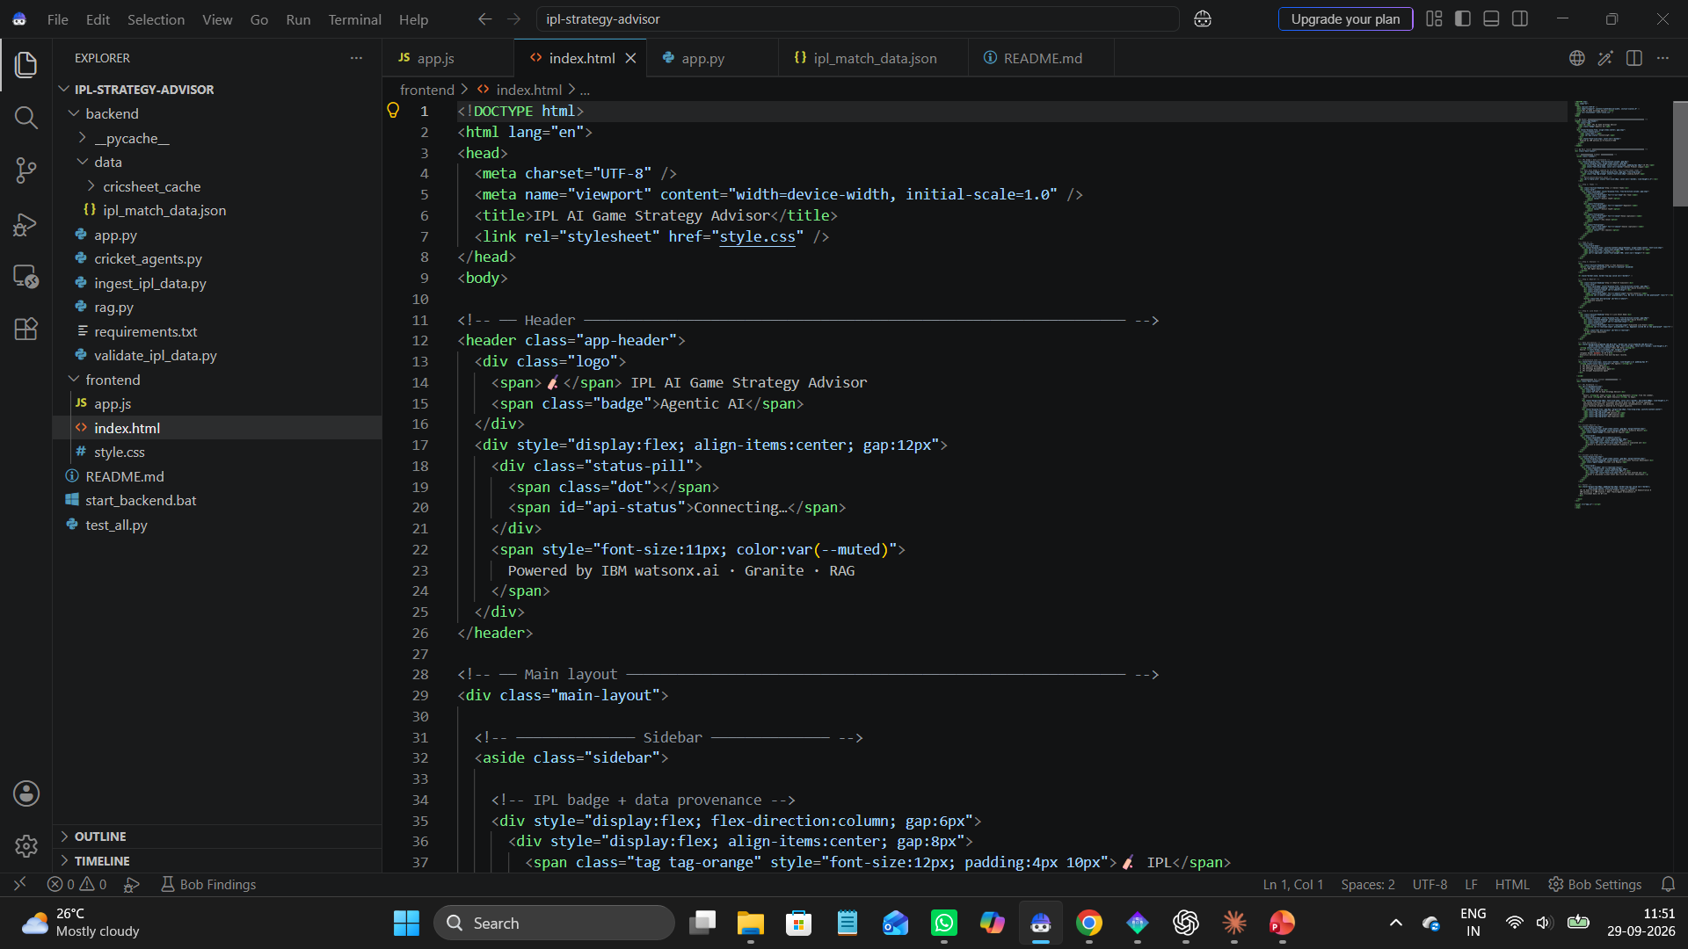
Required Files created using IBM bob -
Backend files (Flask API, agents)
Frontend files (HTML/CSS/JS)
backend/data/ipl_match_data.json
Raw Cricsheet IPL archive
README and project documents
[Insert IBM Bob project files screenshot here]

Slide 7
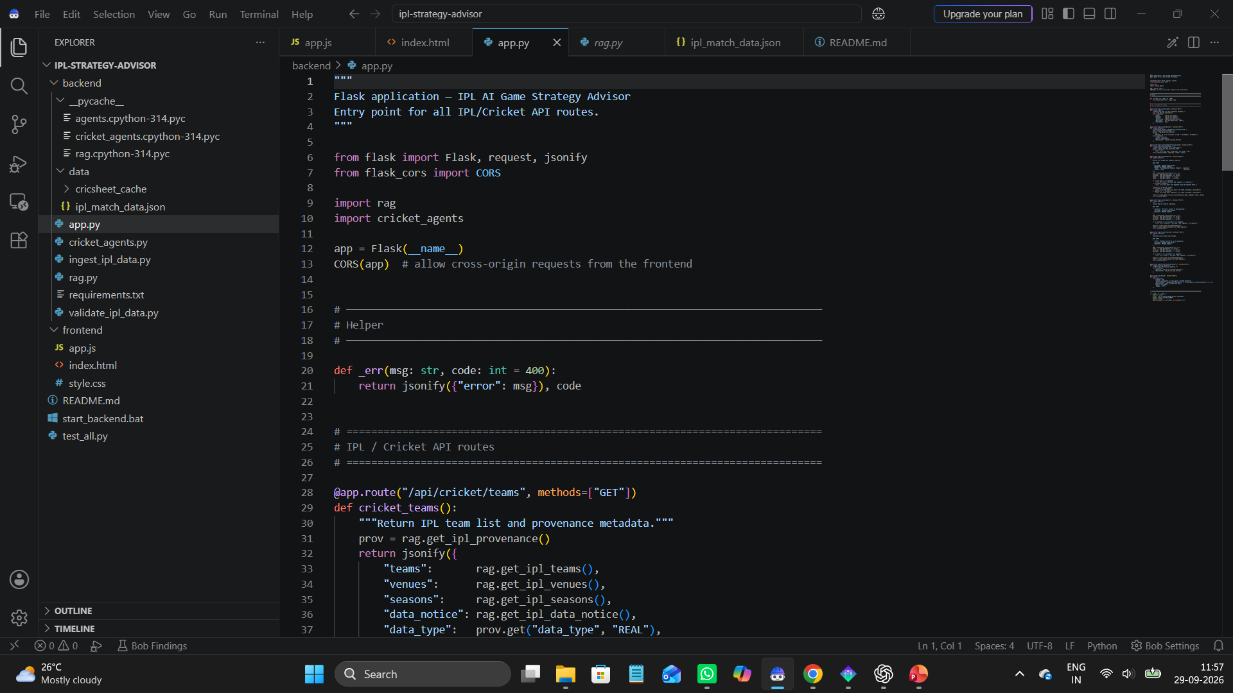
IBM Bob Screenshots:

Slide 8
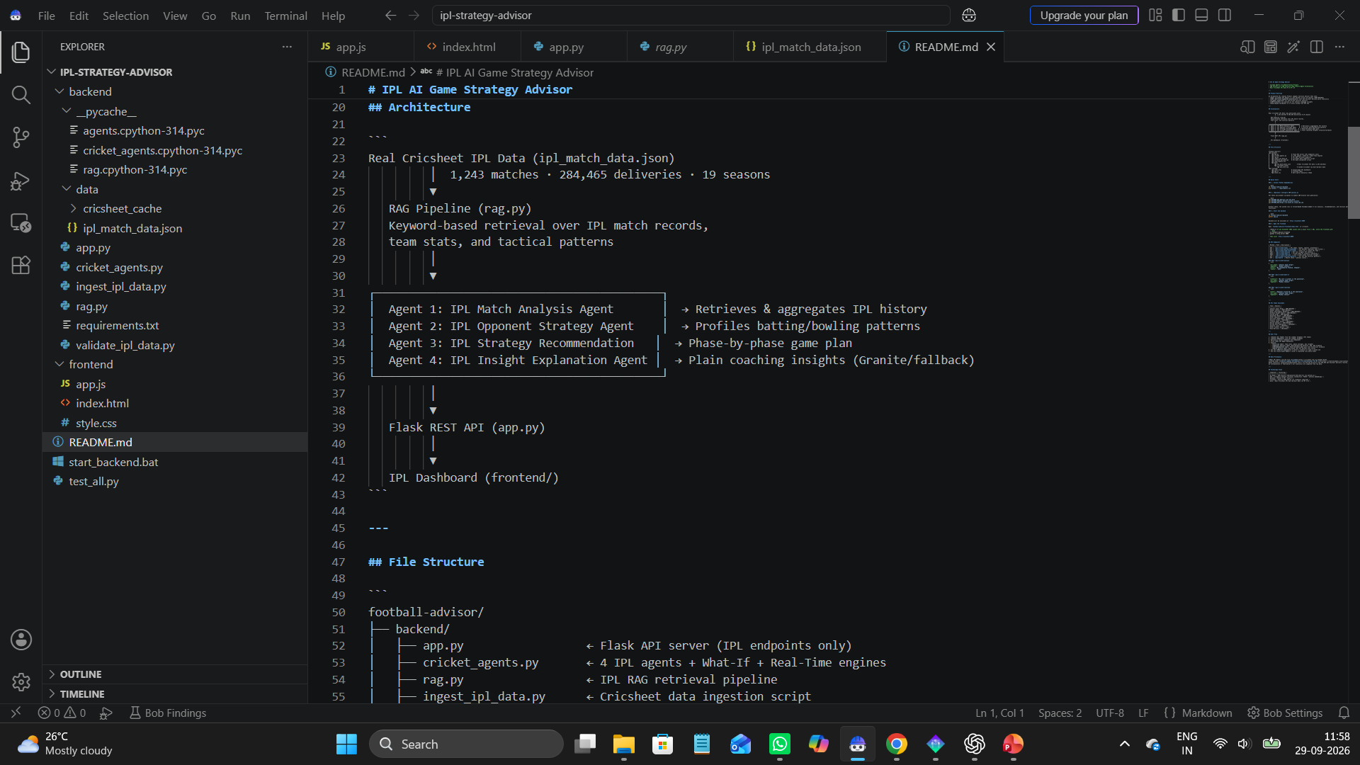
[Insert IBM Bob prompt / workflow screenshot here]

Slide 9
Architecture blueprint for IBM bob:
Multi-Agent System
Match Analysis Agent
User
IPL Strategy Dashboard
Flask Backend / API
Opponent Strategy Agent
RAG / Real IPL Historical Data
Cricsheet IPL Dataset
Strategy Recommendation Agent
Insight Explanation Agent
Output: Strategic Recommendation & Explanation shown on the IPL Strategy Dashboard
AI layer: IBM watsonx.ai + IBM Granite models | Built and orchestrated with IBM Bob

Slide 10

Role of Agentic AI in the solution
Role of Agentic AI in IPL Game Strategy Advisor
Agentic AI lets the system work as a coordinated decision-support system rather than a simple chatbot. Using IBM watsonx.ai and IBM Granite models, multiple specialized agents collaborate to turn historical match evidence into strategy insights.
Each agent performs a specific role — retrieving historical evidence, analyzing the opponent, generating strategic recommendations and explaining the reasoning — while working together. This multi-agent approach keeps the system modular and focused.
The system is context-aware, using the selected team, opponent and match situation, and explainable, since the Insight Explanation Agent presents the supporting historical evidence.
Additionally, agents pass their outputs to one another, enabling better decisions than a single model call.
Overall, Agentic AI makes the system data-driven, modular and strategy-oriented, acting like a smart digital cricket analyst for tactical preparation.

Slide 11
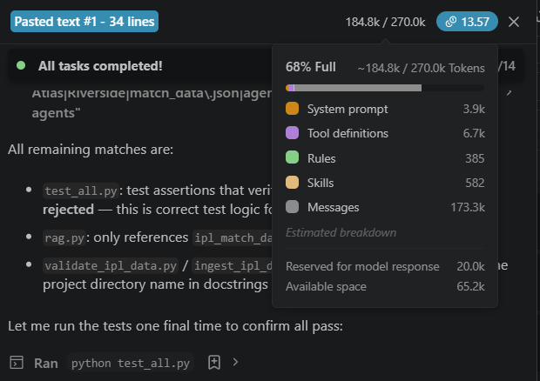
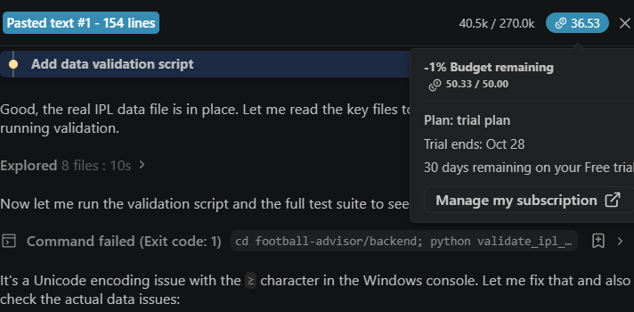
Token Usage
[Add your actual token usage here]

Slide 12
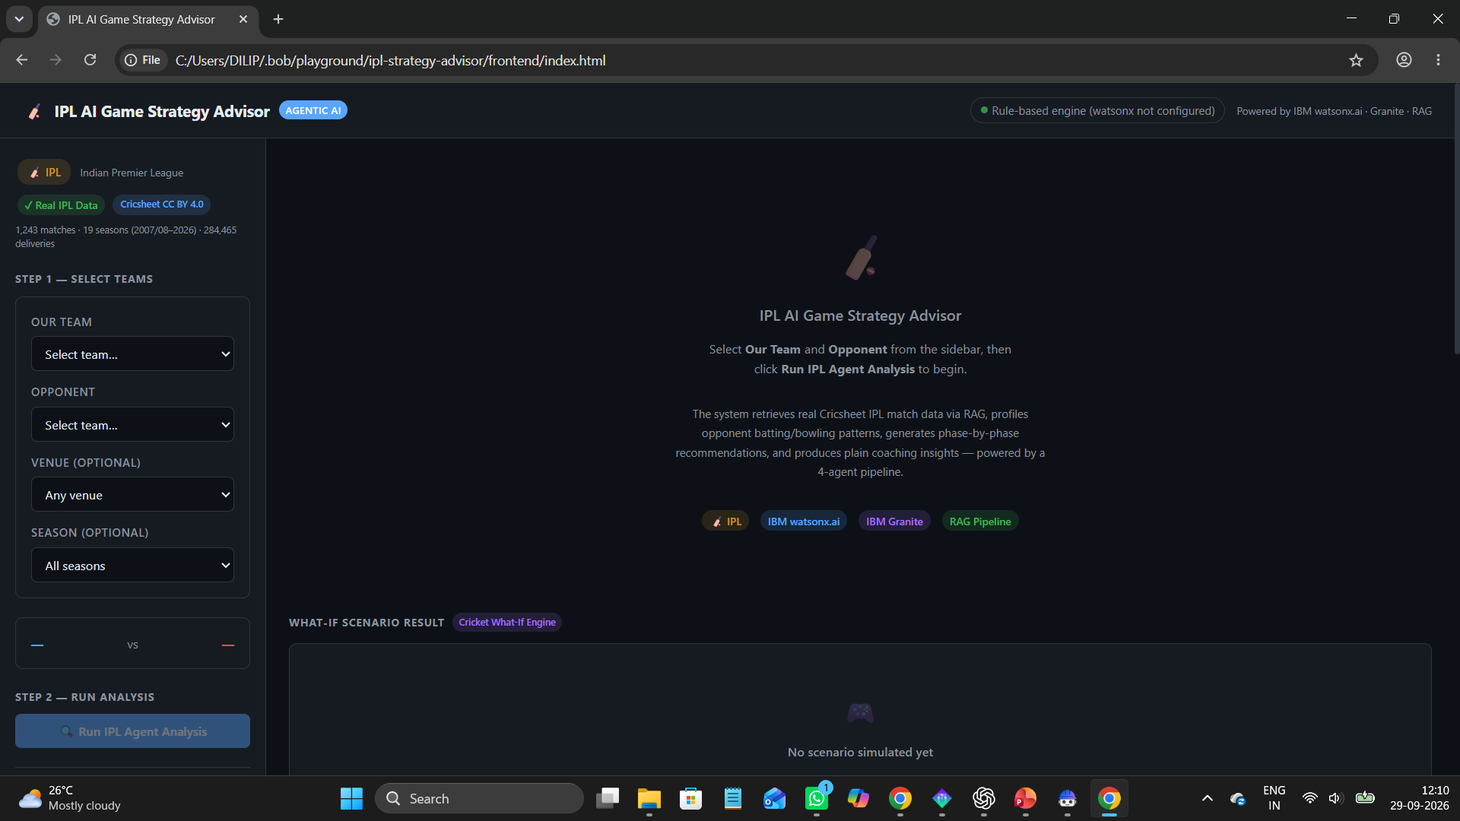
Project Output Screenshot

Slide 13
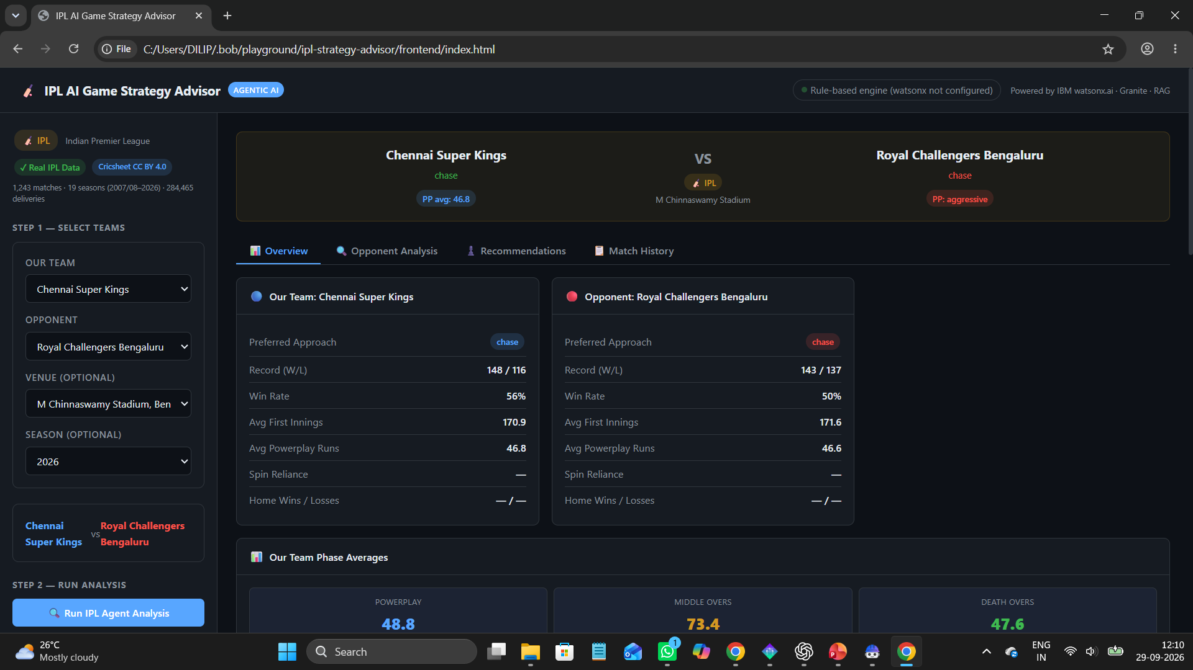
Project Output Screenshot

Slide 14
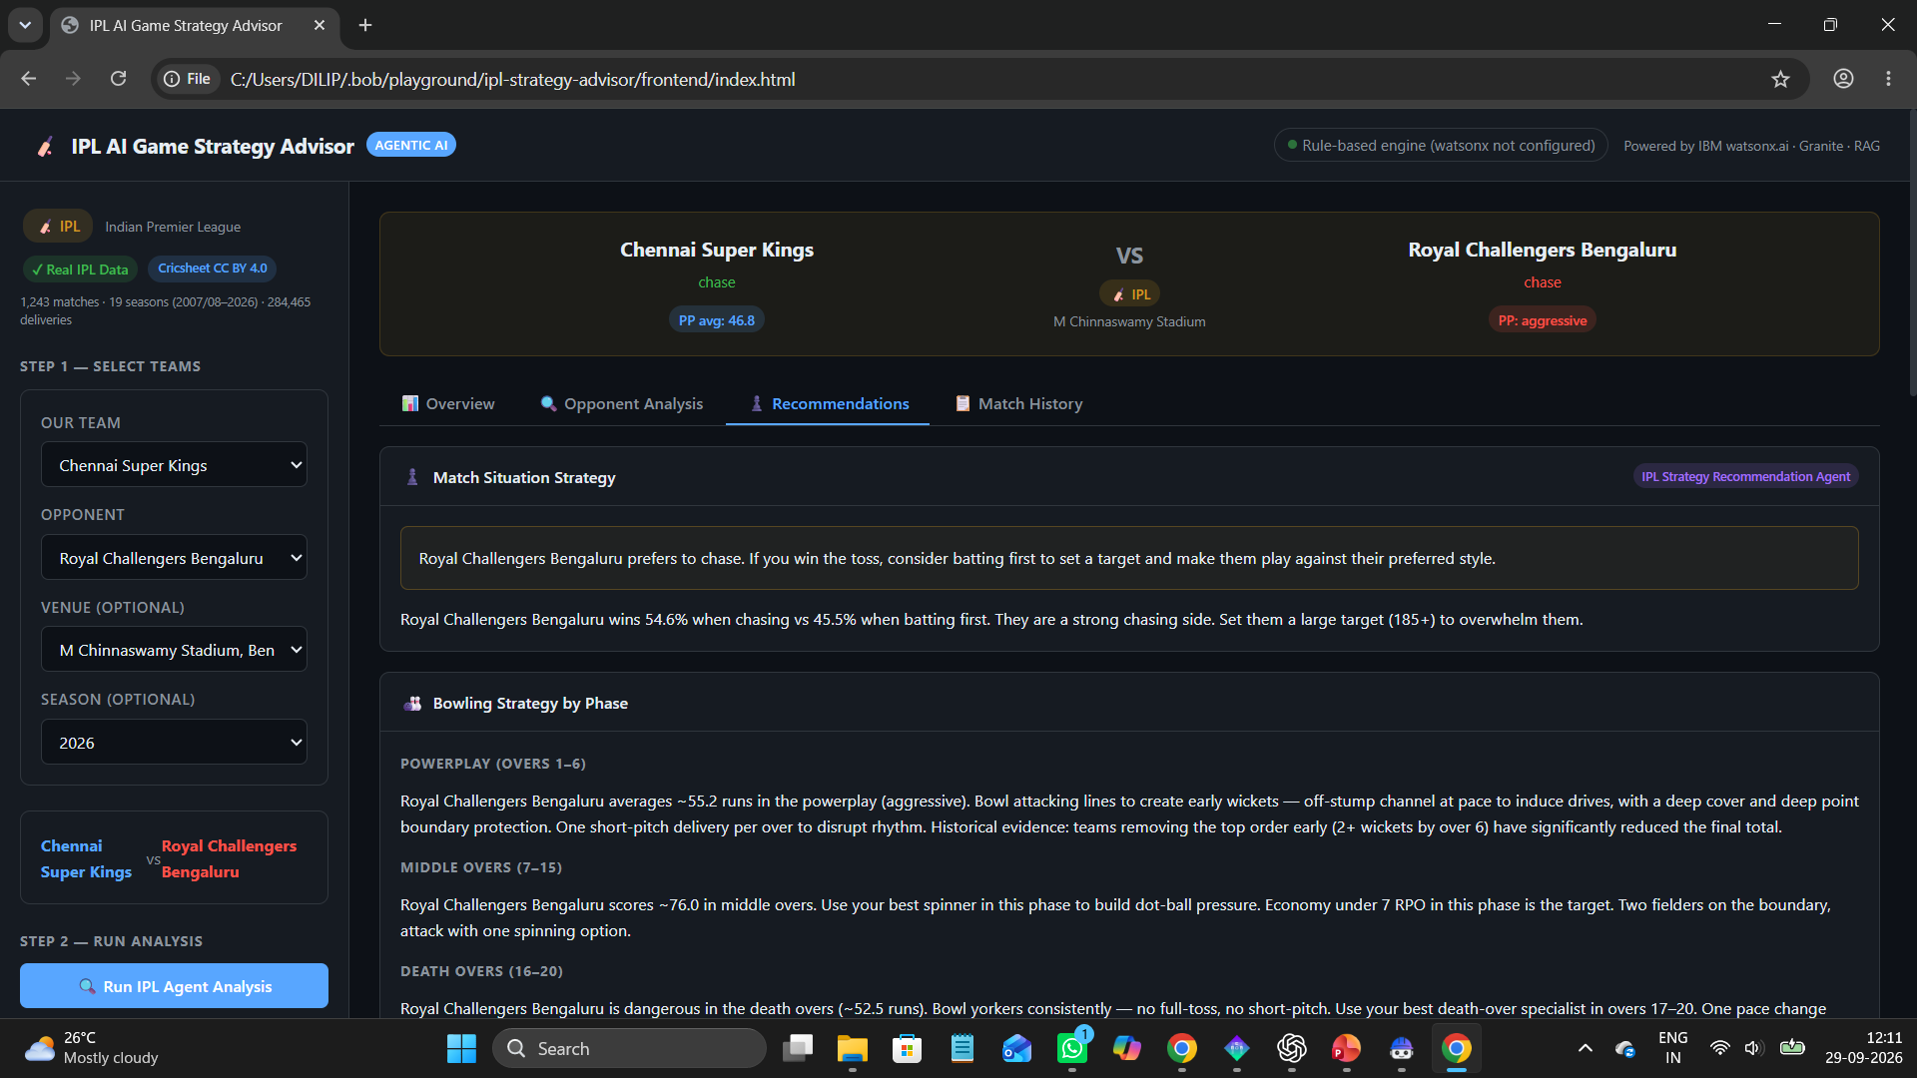
Project Output Screenshot

Slide 15
Novelty and Uniqueness
The proposed IPL Game Strategy Advisor stands out by combining Agentic AI, RAG, and real IPL data into a single intelligent system.
Multi-Agent Cricket Intelligence – Specialized agents collaborate instead of a single chatbot.
Real IPL Data – Built on real Cricsheet IPL ball-by-ball data.
RAG-Based Tactical Analysis – Historical evidence is retrieved before recommendations are generated.
Opponent-Specific Strategy – Analyzes the selected opponent instead of giving generic advice.
Explainable Recommendations – The Insight Explanation Agent shows the reasoning and evidence.
What-If Tactical Simulation – Explore and compare hypothetical tactical scenarios.
Situation-Based Strategic Insights – The Live Event engine gives guidance for match situations.
IBM Granite + Agentic AI Architecture – Built with IBM Bob, watsonx.ai and Granite models.
This makes the solution a data-driven, explainable cricket strategy assistant, not just a statistics viewer.

Slide 16
Git Hub Link
Public GitHub repository URL – https://github.com/Dilip813/IPL-AI-Game-Strategy-Advisor-
The repository contains: 1) Backend files 2) Frontend files 3) IPL-related project files and README 4) Problem statement PDF 5) Final presentation PPT 6) Relevant IBM Bob / agent files

Slide 17
Future Scope
1.Live IPL Data Integration – Integrate real-time match feeds for continuously updated insights.
2.Advanced Player Analytics – Add deeper player-level prediction and matchup analysis.
3.Win Probability Prediction – Add predictive models for match and situation-level probabilities.
4.Computer Vision – Use video/vision models for field-position and player-movement analysis.
5.Voice-Based Strategy Assistant – Allow users to interact with the strategy advisor using voice.
6.Multilingual Support – Provide strategy insights in multiple languages.
7.Advanced Tactical Simulation – Support more detailed scenario-based strategic simulations.

Slide 18
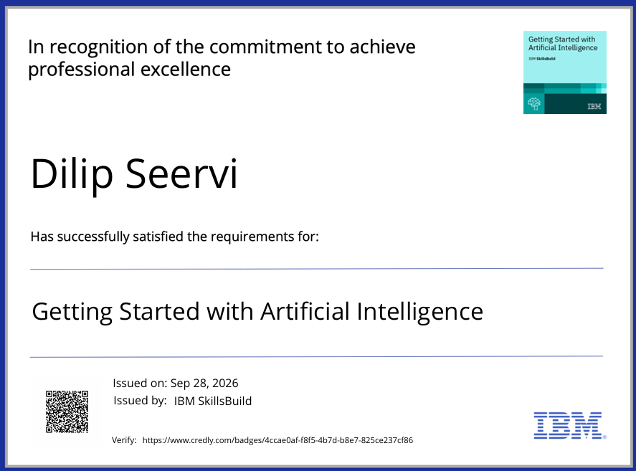
Certificates Earned:
Credly Certificate

Slide 19
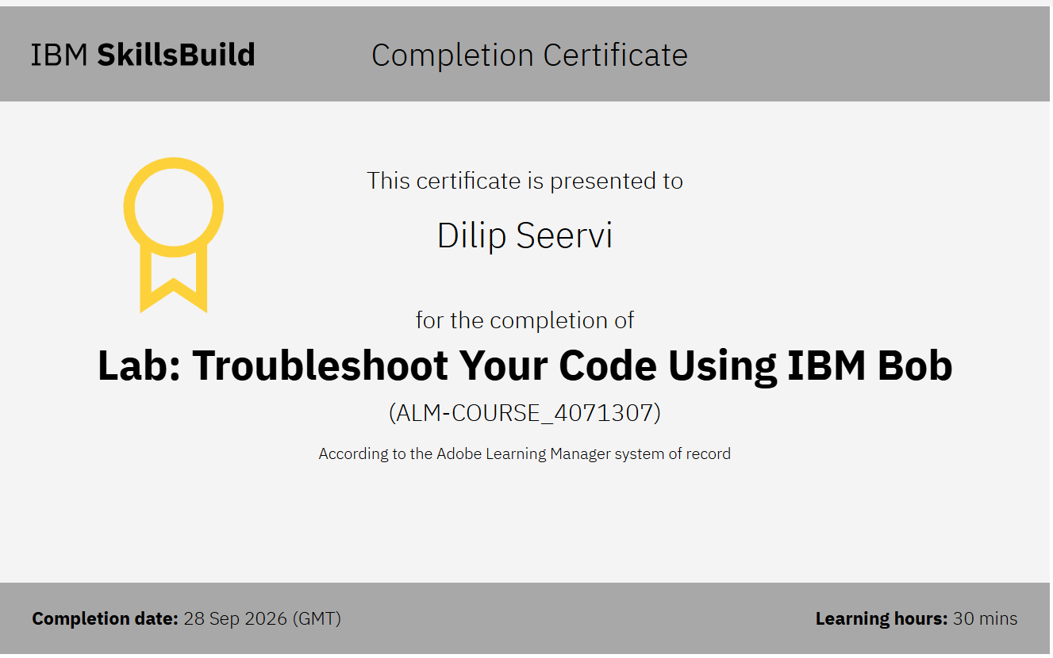
Certificates Earned:​
IBM Bob Certificate

Slide 20


